Slide 1
Geography Mentor Meeting
Agenda
Welcome and national geography PGCE context
Overview of the PGCE geography curriculum and links with the CCF
Mentor role and mentor support
Mentor development work
Developing effective targets
‘What do we do if…’
AOB
17.10.22

Slide 2
Welcome and national PGCE context

Slide 3
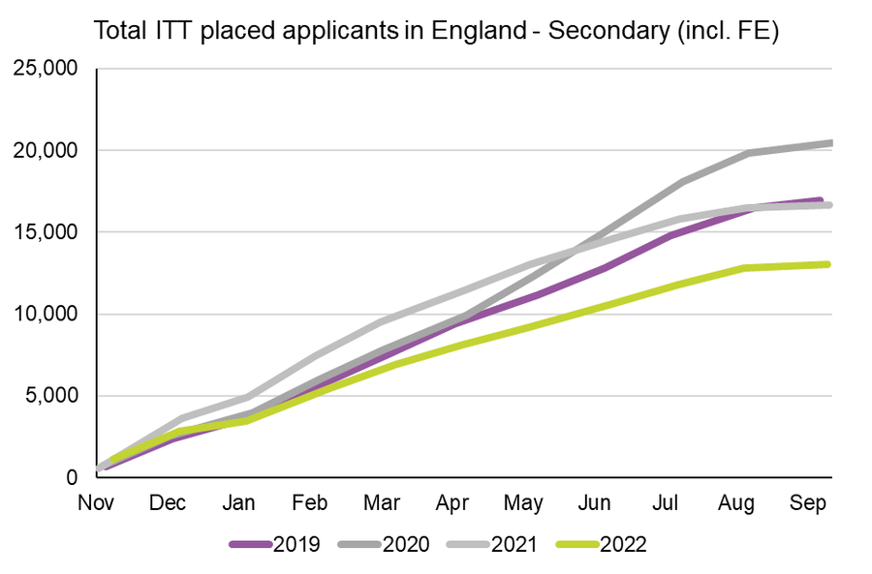

Slide 4
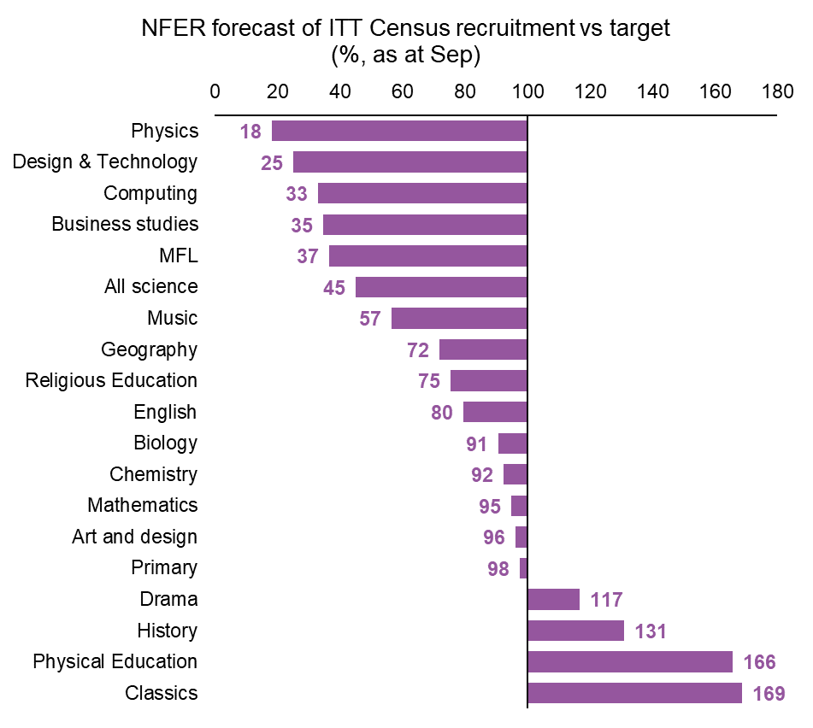
PGCEs Nationally

Slide 5
How I choose to view our geography PGCE in 2022-23

Slide 6
From September 2023
Last week the DfE announced an uplift in the bursary for trainees studying a geography PGCE - £25,000
Spread the word!

Slide 7
2. UoY Geography PGCE Curriculum
Our Curriculum Intent
Geography teachers who train through the University of York PGCE will:
Have deep subject knowledge and curriculum understanding
Be advocates for developing enquiry skills and fieldwork in geography
Use pedagogical approaches to teach geography that are research informed and based on careful reflection
Carefully consider how they represent people and places through their teaching of geography
Be part of a professional community of geography teachers with an ongoing commitment to professional development.

Slide 8
Core Content Framework
Link to CCF

Slide 9
2. UoY Geography PGCE Curriculum Overview
Sept - Dec
Key focus on CCF 1,4,7
Induction Phase: 3 days a week at university/ SD hub and 2 days a week in placement 1 school
Assignment 1: What do you consider to be effective teaching and why?
Placement 1 Block 1 (teaching a minimum of 12 solo lessons)
Review 1
Late Dec - mid Feb
Continue embedding CCF 1,4,7 Key focus on CCF 2,3,6
Mid-placement development: 2 weeks, majoritively at university/ SD hub
Assignment 2: Evaluating your planning, teaching and assessment of a small sequence of learning
Placement 1 Block 2 (working up towards a 50% timetable)
Review 2

Slide 10
2. UoY Geography PGCE Curriculum Overview
Mid Feb - March
Continue embedding CCF 2,3,6 and Key focus on CCF 5, 8 & PPC
Transition to new school: 3 days a week at university/ SD hub and 2 days a week in placement 2 school
Placement 2 Block 1 (quickly working up towards a 50%-60%+ timetable)
Assignment 3 (Part A): Conduct your own small-scale classroom-based research (initial focus on reading and existing research) - main launch 25th March
Review 3
April - June
Continue embedding CCF 5,8 & PPC and
Key focus on enrichment
Placement 2 Block 2 (You should undertake a further 20-25% of timetabled involvement so your timetable reaches 70-80%.)
Assignment 3 (Part B): Conduct your own small-scale classroom-based research (carry out own research)
Review 4
2 weeks university/ SD provision - enrichment
2 weeks enrichment placement
Final week - reflection and celebration

Slide 11
Curriculum Detail - Sessions Covered
Link to curriculum map
CCF Links

Slide 12
3a.i What is the role of the mentor?
“A mentor is a suitably experienced teacher who has formal responsibility to work collaboratively within the ITT partnership to help ensure the trainee receives the highest-quality training.”
National Standards for school-based initial teacher training (ITT) mentors, July 2016

Slide 13
What does a mentor do?
Mentors who take on the role will be able to draw on a wide range of relevant experiences, strategies and techniques from other aspects of their work. At different times the mentor is:
a coach who provides a model of effective teaching and sharing practice
a critical friend who observes the new teacher’s teaching and offers encouragement to develop expertise
a trainer in geography subject knowledge and pedagogy
an assessor for the Teachers’ Standards.

Slide 14
Trainees’ views of a good mentor
Link

Slide 15
A recommended read

Slide 16
3a.ii Key Dates (Placement 1)
Friday 28th October - Trainee assignment 1 deadline
Tuesday 1st November - Trainees begin their block placement 1
Friday 9th December - Review 1 (completed on PebblePad)
w/c 12th December - Trainees only in school on Tuesday & Thursday
w/c 2nd January - Trainees NOT in school
Monday 30th January 4-6pm - Geography mentor meeting
Friday 3rd February - Review 2 (completed on PebblePad) & trainee’s last day in placement 1 school
Tuesday 7th & Thursday 9th February - Trainees induction days in placement 2 setting
Friday 17th February - Trainee assignment 2 deadline
Monday 20th February - Trainees begin their second school block placement

Slide 17
3a.iii Assignment 2
Assignment 2 is formally launched with the trainees on Monday 12th December
Addressing each CCF area (2,3 & 6) as a separate sub-section of your assignment evaluate:
● Your planning
● Your teaching
● Your assessment
of a sequence of lessons (approximately 4-6 lessons). You can do this by carefully examining pupils’ work and any feedback you received from an observer during the time you teach your sequence of lessons.

Slide 18
3b. Support for Mentors
UoY PGCE mentor website
Mentor handbook
Geography subject specific target examples
PebblePad explained - video 5 mins
Shared mentor Google Drive
Regular mentor email updates (approx. every 2 weeks)
Quick response to emails regarding any concerns regarding a trainee

Slide 19
3. Host Teacher Consistency
What support is needed? - JE

Slide 20
3. Placement 1 Requirements
Link

Slide 21
Any questions regarding placement 1 requirements?

Slide 22
4. Mentor Development Work
Developing effective targets - Pedagogy Focus
These are all targets that were set during mentor meetings in placement 1 last year. Any comments?
Add more pace into lessons
Try out 2 or 3 strategies for improving behaviour
Use your voice
Learn how to plan more cohesive lessons
Use more AfL

Slide 23
4. Mentor Development Work
Developing effective targets - Pedagogy Focus
How could we make these more meaningful/ SMART?
Add more pace into lessons
Try out 2 or 3 strategies for improving behaviour
Use your voice
Learn how to plan more cohesive lessons
Use more AfL

Slide 24
4. Mentor Development Work
Developing effective targets - Subject Specific Focus
The most common subject specific target we see is
‘Improve your subject knowledge of…’

Slide 25
4. Mentor Development Work
Developing effective targets - Subject Specific Focus
Link to trainee subject knowledge audit
Link to geography subject specific target examples
Link to ‘CCF menu’

Slide 26
4. Mentor Development Work
What do we do if…
The trainee has a couple of lessons where the students demonstrate limited progress
The trainee is not punctual for school/ a lesson
The trainee starts to cry (in a mentor meeting) because they feel overwhelmed with their workload
The trainee is not getting learning plans/ resources to you/ host teacher 48 hours in advance
You think the trainees teaching is not progressing at the expected level

Slide 27
4. Mentor Development Work
What do we do if…
… any scenarios that you would like to discuss?

Slide 28
5. Any Other Business?
Ofsted

Slide 29
Ofsted for ITE/ ITT - what this means for us as mentors
We are overdue an inspection (last inspected in 2013, normally a 5-6 year cycle), Ofsted also keen to visit providers where there is a new PGCE
New inspection framework from Sept 2020
When we are inspected by Ofsted, they will want to talk to mentors as part of the UoY partnership.
The ITE Ofsted approach is similar to that of schools and they will be looking at what happens across both the university and school based provision closely to see if our intent is implemented and then has impact.

Slide 30
Ofsted for ITE/ ITT - what this means for us as mentors
By meeting with mentors, Ofsted will want to assess how well we all work together to produce the next generation of competent and confident early career geography teachers.
If it is useful, I have produced a 2-sided summary document, designed to give clarity and consistency of messages across the partnership of schools
This 2 sided summary covers:
our curriculum ambition
how the Core Content Framework (CCF) is addressed through our taught programme (which you then compliment with the school based experience, your weekly meetings and the sessions delivered in school)
how we have addressed previous Ofsted targets
some of the questions we are expecting.

Slide 31
Ofsted for ITE/ ITT - questions we are expecting
How are you supported by the university?
How are you implementing the Core Content Framework (CCF)?
We think there will be a question about the ‘purposeful integration’ of the university and school experience , i.e. ‘the connectedness of the curriculum from subject and centre based training into placement experiences’ - this is where it will be really important to know our curriculum model
There is likely to be something around an ‘ambitious curriculum’
There is likely to be something around subject specific pedagogy

